Slide 1
Finance Intelligence Dashboard
Transforming Financial Data into Strategic Insights
By Faizan Qureshi
“This dashboard brings together key financial metrics Sales, Profit, and Performance across products, segments, and geographies to enable smarter, faster business decisions.”

Slide 2

Objective of the Dashboard
To centralize financial data into one interactive visualization.
To identify profit-driving products and customer segments.
To analyze performance trends over time and geography.
To enable decision-makers to act quickly using real-time insights.

Slide 3
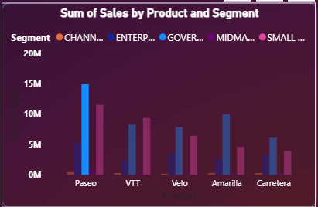
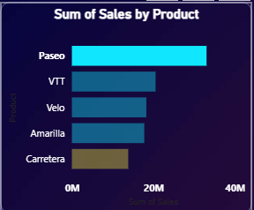
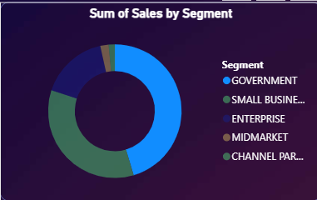
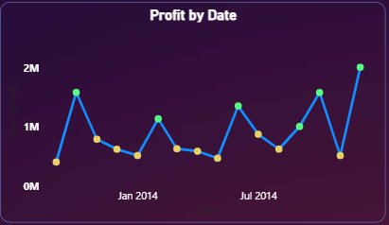
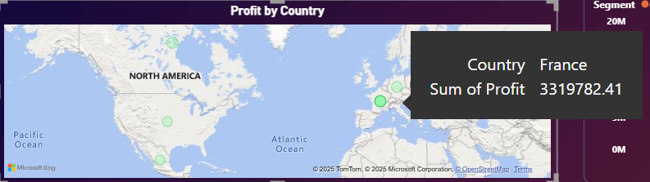
Questions This Dashboard Answers
Which product and segment combination impact overall sales?
Which products generate the highest sales and profits?
Which customer segments are most valuable?
How does profit change over time?
Which countries or regions perform best?
PASEO - GOVERNMENT
PASEO
GOVERNMENT
FLUCTUATING UPWARD TREND
FRANCE

Slide 4

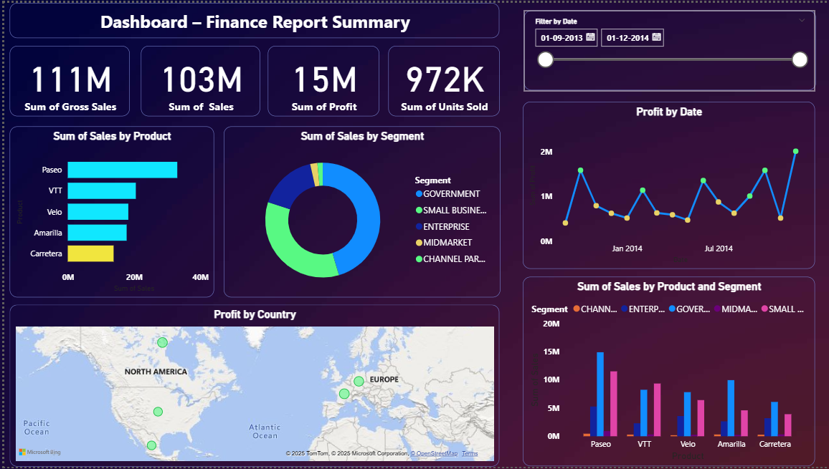
Power BI Dashboard Overview
Dashboard Title
High-level financial summary
Date filtering slider
Top-selling products
Profit trend over time
Segment-wise distribution
Regional performance overview
Best performing product
segment pair

Slide 5

Performance Snapshot
Metric | Value | Insight
Gross Sales | ₹111M | Strong revenue performance
Sales | ₹103M | Slight reduction due to discounts/returns
Profit | ₹15M | ~14% profit margin healthy stability
Units Sold | 972K | High sales volume across regions
₹111M
Gross Sales
₹103M
Sales
₹15M
Sales
₹972K
Units sold

Slide 6

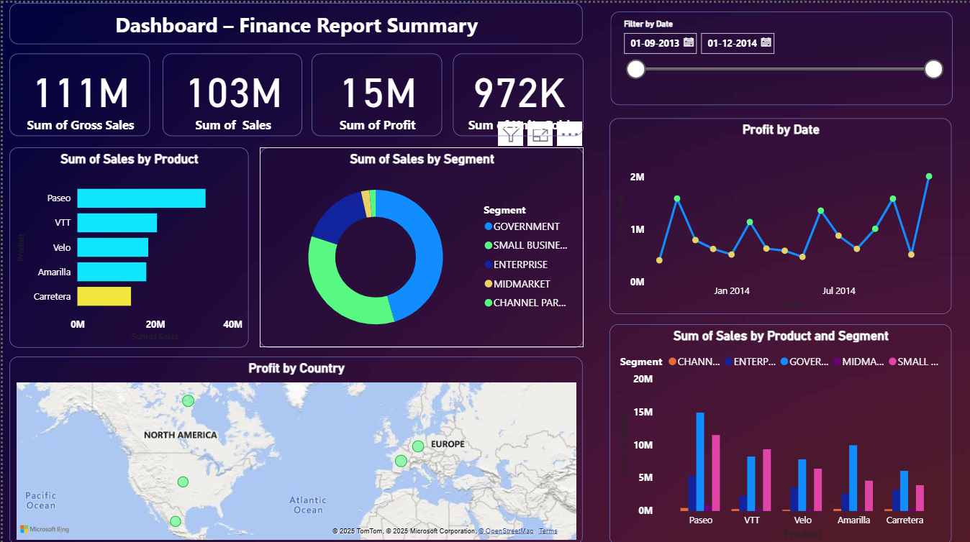
Profit Trend Over Time
KEY INSIGHTS
Mid-year dip may indicate lower demand or marketing gaps.
Suggest focus on mid-year campaigns to stabilize growth.
Notable peaks in Jan, Jul, and Dec.
“Profit fluctuates moderately across months, peaking around Q2 and Q4 suggesting strong seasonal performance.”

Slide 7

Regional Performance Analysis
CANADA
GERMANY
FRANCE
USA
MEXICO
Country | Sum of Profits
France | 3.3 Million
Canada | 3.2 Million
Germany | 3.1 Million
USA | 2.5 Million
Mexico | 2.5 Million
Top Country: France- highest contribution to profit.
Secondary Market: America- growing customer base.
Action Point: “Focus on expanding mid-market and enterprise customers in these regions.”

Slide 8

Business Impact and Key Recommendations
IMPACT
60% reduction in report preparation time.
Real time decision making through visuals.
Unified data view across departments.
Revisit pricing strategy for low-performing products.
Strengthen marketing in underperforming months.
Introduce predictive forecasting for proactive planning.
RECOMMENDATIONS

Slide 9


THANK YOU
Questions & Discussion
By: Faizan Qureshi

